Slide 1

Vel Tech Rangarajan Dr. Sagunthala R&D Institute of Science and Technology
School of Computing
Department of Computer Information Technology
10211IT224/ FULL STACK APPLICATION DEVELOPMENT (JAVA)
END SEMESTER PROJECT REVIEW
Date: 06-05-2026
SMART CAMPUS EVENT MANAGEMENT SYSTEM
SDG: SDG4 – Quality Education
Courses Handling Faculty:
Dr. HAFIZUR RAHMAN
Assistant Professor
Presented By:
S.Raga Suprathika Lakshmi– VTU25169 – 23UECS1208

Slide 2
INTRODUCTION
1
In today’s digital age, managing campus events manually leads to inefficiencies, miscommunication, and lack of centralized information for students and administrators.
Many institutions rely on notice boards or scattered platforms, which makes it difficult for students to stay updated about upcoming events and registrations.
There is a growing need for a centralized, automated, and user-friendly system to manage campus events effectively.
The Smart Campus Event Management System is a web-based application designed to organize, manage, and track campus events such as workshops, seminars, and technical fests
It allows students to browse events, register online, and view their registered events, while administrators can perform CRUD operations (Create, Read, Update, Delete) on event details.It allows users to perform CRUD operations (Create, Read, Update, Delete) on expense records.
The platform provides analytical features such as event-wise registration counts and filtered search options based on date, department, and event type.
The system is developed using Spring Boot, Spring MVC, Spring Data JPA for backend and HTML, CSS, Bootstrap, and ReactJS for frontend, ensuring a scalable, responsive, and secure application.
2
3
4
5
6
7
8
9

Slide 3
PROBLEM STATEMENT
1
In today’s fast-paced digital world, individuals and small organizations face significant challenges in managing their expenses efficiently. Most users still depend on traditional methods such as notebooks, paper records, or basic spreadsheets, which are not only time-consuming but also highly prone to human errors and poor data organization. These approaches lack a structured mechanism to maintain relationships between users and their expense records, making it difficult to track, retrieve, and analyze financial data accurately.
Furthermore, the absence of a centralized and automated system limits the ability to generate meaningful insights such as total expenditure, category-wise analysis, and spending patterns. Existing financial management solutions are often complex, costly, or tailored for large enterprises, making them unsuitable for small-scale users. As a result, users are unable to make informed financial decisions due to the lack of real-time analytics and efficient data handling.
Therefore, there is a need to develop a simple, cost-effective, and web-based relational expense management system that can efficiently store, manage, and analyze expense data, while providing accurate insights and an easy-to-use interface for better financial control.
2
3
4
5
6
7
8
9

Slide 4
OBJECTIVE(S)
1
2
To design and develop a responsive web-based Smart Campus Event Management System for efficiently managing campus events using Spring Boot, ReactJS.
To implement secure CRUD operations and enable features such as event registration, search, and analytical reporting (event-wise registrations) using Spring Data JPA and a relational database system.
3
4
5
6
7
8
9

Slide 5
PROPOSED SYSTEM
1
Complete Event Management Solution – Smart Campus Event Management System is a web-based platform that enables colleges/universities to efficiently manage campus events, workshops, and seminars. It allows students to browse, register, and track events, while administrators can manage event details and monitor participation.
Secure Data Handling – Implements Spring Security and backend validation mechanisms to ensure secure user authentication and data protection. Uses a relational database to maintain data integrity and prevent unauthorized access.
Dynamic Event Management – Event details are stored in a relational database and displayed dynamically through web pages. The system supports real-time updates for event creation, registration, and modifications.
Relational Database Structure – Maintains structured relationships between entities such as Users, Events, and Registrations using primary and foreign keys for consistency and efficient data retrieval.
Real-Time Analytics & Reporting – Provides insights such as total number of registrations, event-wise participation, and filtered search results based on date, department, and event type.
Fully Responsive Web Design – Developed using HTML, CSS, Bootstrap, and Thymeleaf to ensure compatibility across desktops, tablets, and mobile devices.
2
3
4
5
6
7
8
9

Slide 6
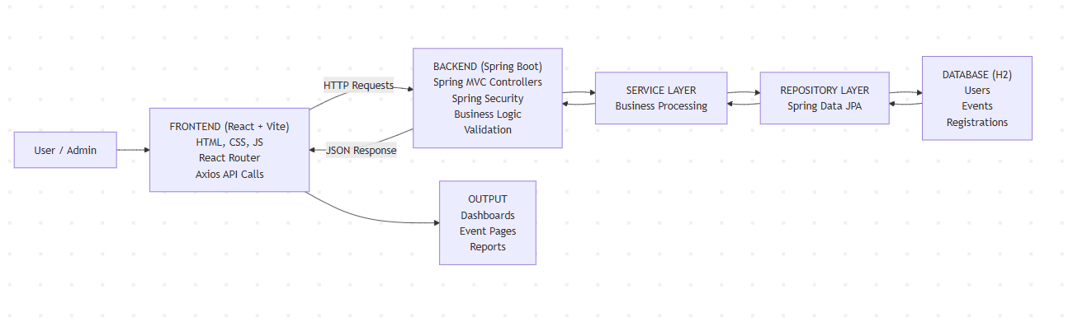
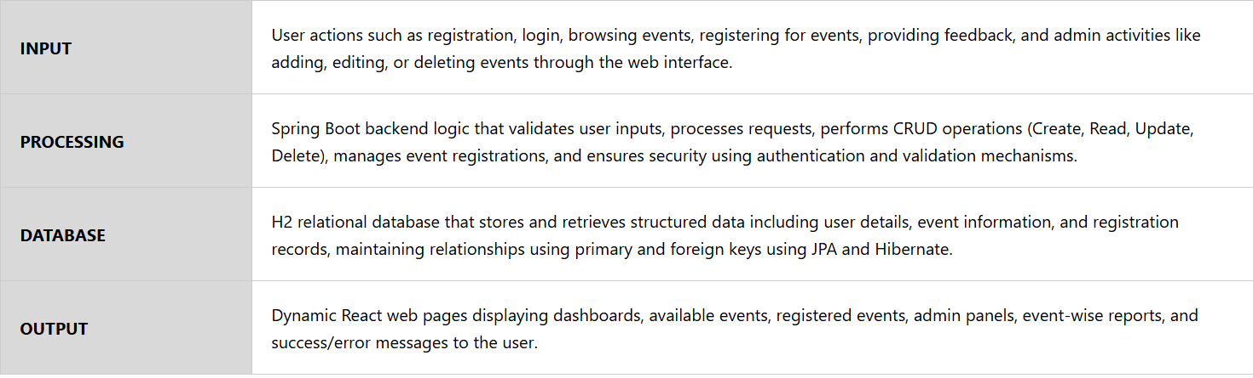
PROPOSED SYSTEM ARCHITECTURE
1
2
3
4
5
6
7
8
9

Slide 7
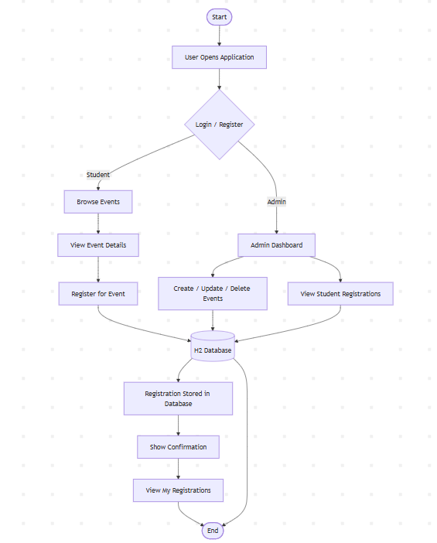
WORKFLOW
1
2
3
4
5
6
7
8
9

Slide 8
TECHNOLOGIES USED
1
2
Frontend: HTML5, CSS3, JavaScript, Thymeleaf
Backend: Java 17, Spring Boot 3.2.4, Spring Web (REST APIs),
Database: H2 In-Memory Relational Database (for development), Entity Mapping using JPA (Users, Events, Registrations Tables)
Tools: Apache Maven (Backend Build Tool), Vite (Frontend Build Tool), VS Code (Development Environment), ESLint (Code Quality), Embedded Tomcat Server, Web Browser (Chrome/Edge)
Hardware Requirements: Minimum 4GB RAM, 20GB free storage, Intel i3 processor or above
Software Requirements: Windows / Linux / macOS, Apache Server, PHP 7.4 or above, MySQL 5.7 or above, Modern Web Browser
3
4
5
6
7
8
9

Slide 9
MODULE DESCRIPTION
Module 1: User Management
This module manages user accounts within the system, including student and admin roles. It allows user registration, login, and authentication using secure mechanisms. Each user is uniquely identified and assigned roles for access control. The module ensures proper handling of user sessions and role-based permissions.
Module 2: Event Management
This module handles all event-related operations such as adding, editing, deleting, and viewing events. Admin users can manage event details like title, date, description, and category. It performs CRUD operations efficiently. Events are stored in the database and displayed dynamically to users.
Module 3: Registration Management
This module manages event registrations by students. Users can register for events and view their registered events. It maintains the relationship between users and events using relational mapping. The module ensures accurate tracking of participation data.
Module 4: Database Management
This module manages data storage and retrieval using a relational database (H2/MySQL). It maintains relationships between Users, Events, and Registrations tables using primary and foreign keys. It ensures structured and consistent data handling through JPA and Hibernate.
Module 5: Analytics & Reporting
This module provides insights such as total registrations and event-wise participation details. It retrieves and processes data dynamically for analysis. Reports are displayed in a user-friendly format through dashboards. It helps administrators make informed decisions.
1
2
3
4
5
6
7
8
9

Slide 10
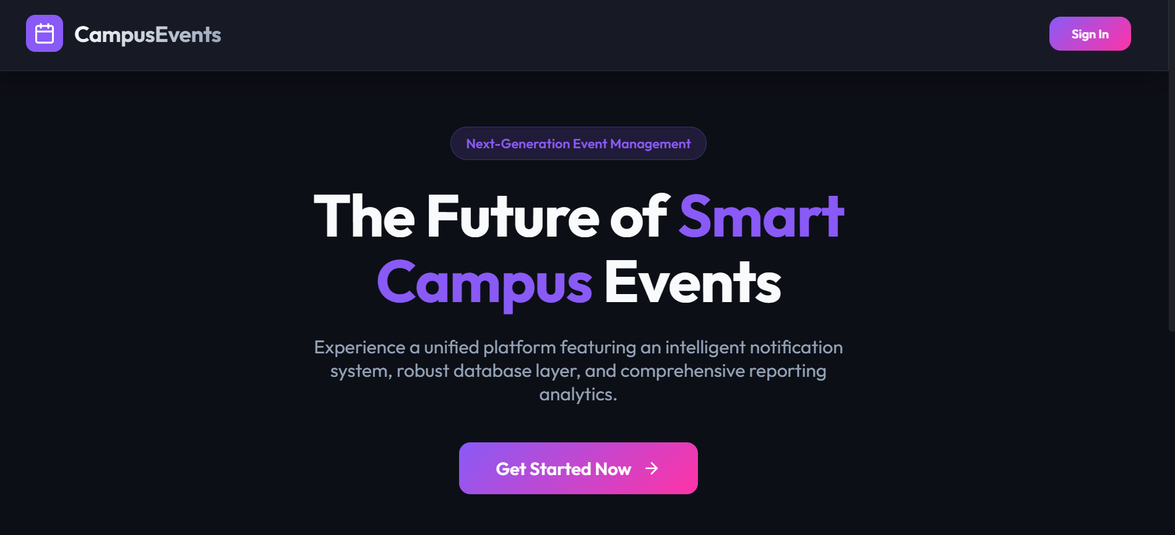
IMPLEMENTATION SCREENSHOTS
1
2
3
4
5
6
7
8
HOME PAGE: Discover and register for campus events like workshops, seminars, and networking sessions with ease.Stay connected, enhance your skills, and manage your event participation in one place.
9

Slide 11
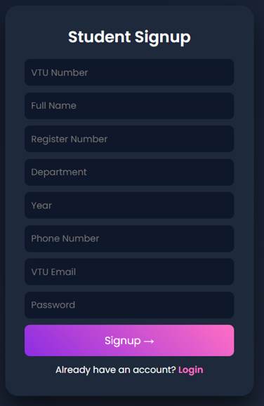
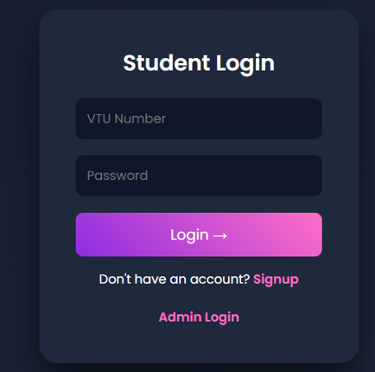
IMPLEMENTATION SCREENSHOTS
Login Page:
Access your account to explore events, manage registrations, and stay updated.Sign in securely to continue your campus event experience.
Signup Page:
Create your account to discover, register, and participate in campus events.Join now to connect, learn, and enhance your campus journey.

Slide 12
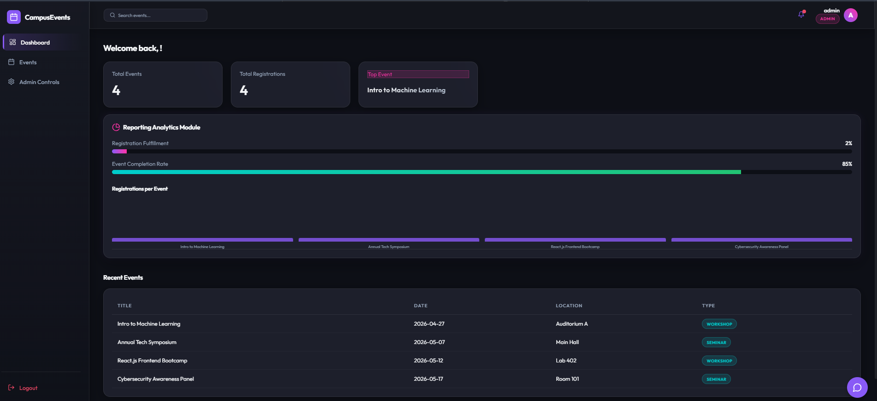
IMPLEMENTATION SCREENSHOTS
1
2
3
4
5
6
7
8(A)
9
Admin Dashboard:
Manage and monitor all campus events and registrations from a centralized dashboard. Create, update, and track events efficiently while gaining insights into participation.

Slide 13
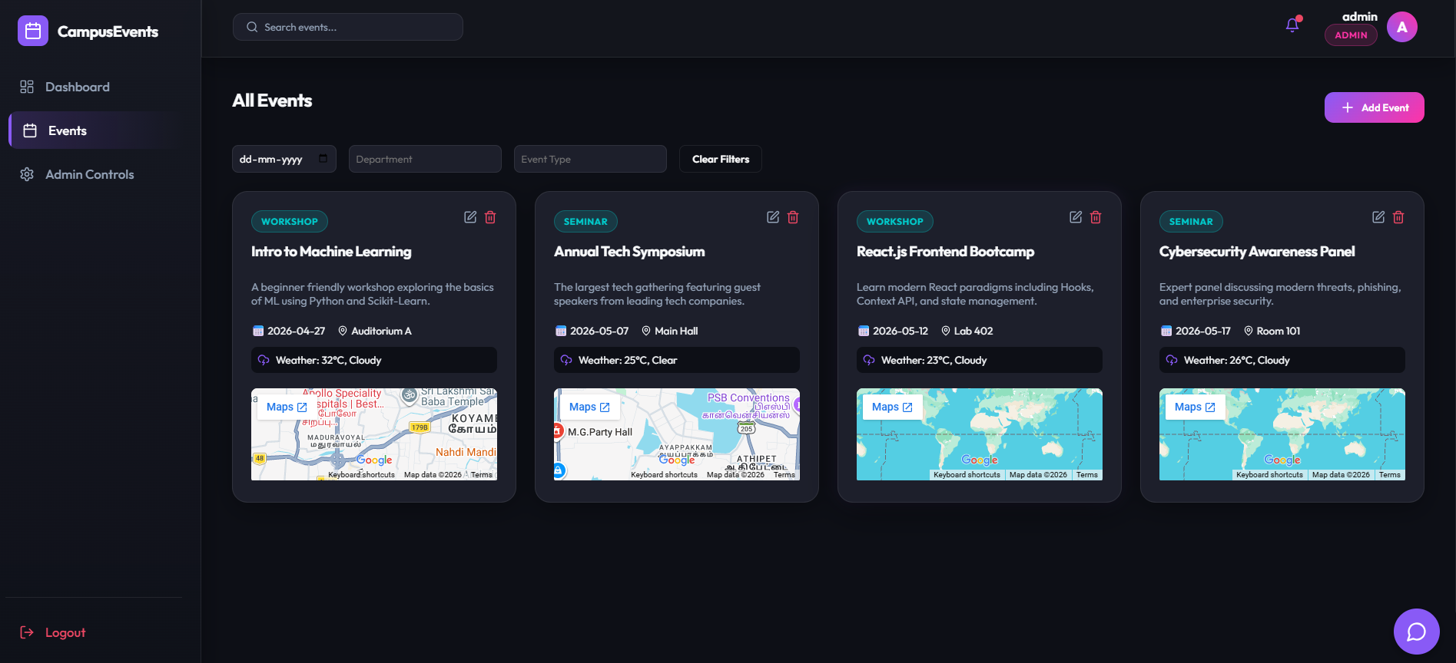
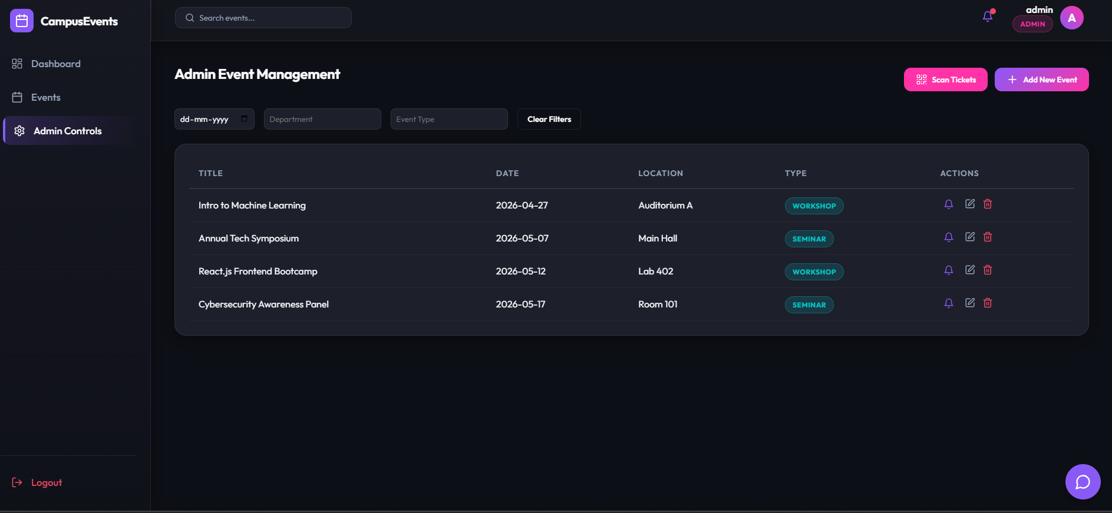
IMPLEMENTATION SCREENSHOTS
1
Manage Events Page (Admin):
Create and manage campus events by adding details like title, date, department, and capacity. Easily organize and update events to ensure smooth coordination and participation.
2
3
4
5
6
7
Student Registrations (Admin View):
View and monitor all student registrations for campus events in a centralized dashboard. Track participant details, event information, and registration dates for better management and analysis.
8(B)
9

Slide 14
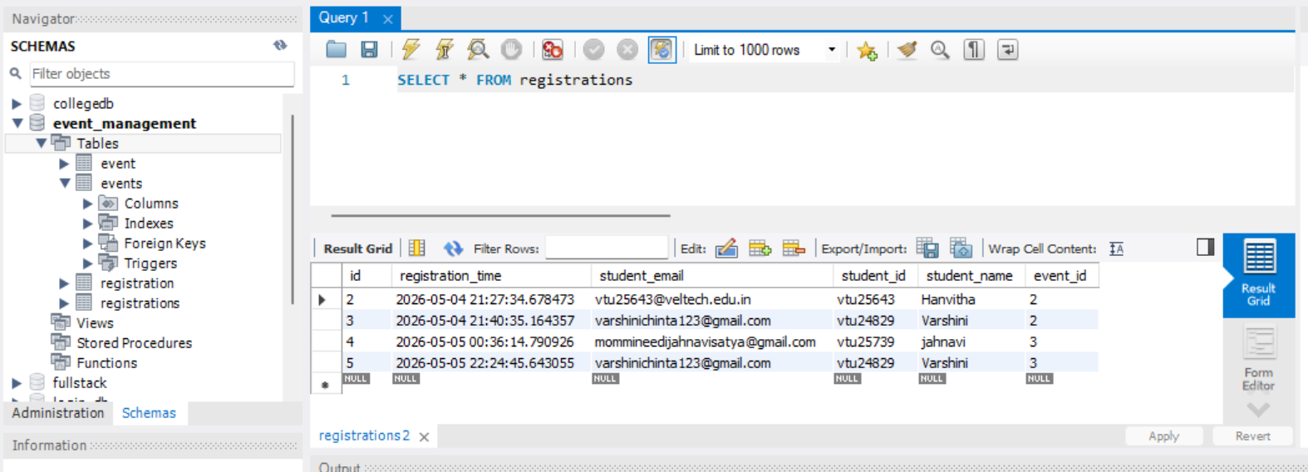
IMPLEMENTATION SCREENSHOTS
1
2
3
4
5
6
7
8(C)
The Database Page in the Smart Campus Event Management System is designed for administrators to view, manage, and control all the stored data in an organized manner.
It acts as the central management interface where all important information related to users, events, bookings, and transactions is maintained.
9

Slide 15
ADVANTAGES & LIMITATIONS
1
Advantages:
• Simple and user-friendly interface for easy event browsing and registration • Centralized system for managing all campus events efficiently • Supports full CRUD operations for event management by admin • Secure authentication and role-based access (Admin & Student) using Spring Security • Real-time updates of event registrations and participation data • Responsive design compatible with desktop, tablet, and mobile devices • Efficient relational database structure ensuring data integrity
Limitations:
• Limited advanced data visualization (no graphical dashboards or charts) • Uses H2 in-memory database, so data is lost after application restart • Application is not deployed on the cloud (runs locally) • Limited notification system (no email/SMS alerts for events) • No export feature for reports (PDF/Excel) • Requires internet or local server setup to access the system
2
3
4
5
6
7
8
9

Slide 16
Thank you

